Slide 1
VIVEKANANDHA COLLEGE OF ENGINEERING FOR WOMEN Elayampalayam – 637205, Tiruchengode, Namakkal Dt., Tamil Nadu.
Department of Electronics and Communication Engineering
Raspberry Pi Based Smallest Touchscreen Laptop With E- Ink Display
PRESENTED BY
GUIDED BY
MRS Dr.S. KOKILA AMIGOS
Ap/ECE
N.Sowmiya
T.Pavithra
R.Sowmiya
S.Divyadharshini

Slide 2
Outline
1.Problem 2. Solution 3.diagram 4.Autonomus 5.Components 6.Realistic utitlity

Slide 3
Problem
•The results is a minimalist mobile computing platform which probably has a much longer battery life and higher reliability than portable Pi solutions using LCD displays, and certainly takes up less space than many others. •Some might complain that there’s no hack in wirelessly connecting such devices, but we’d argue that spotting the possibility when so many others embark on complex builds has an elegance all of its own.

Slide 4
Solution
• In the years since the Raspberry Pi and other similar inexpensive Linux-capable single board computers came to the market, we have shown you a huge variety of projects using them at the heart of portable computers.
•These normally take the form of a laptop or tablet project, but today we have one that starts from a completely different perspective.

Slide 5
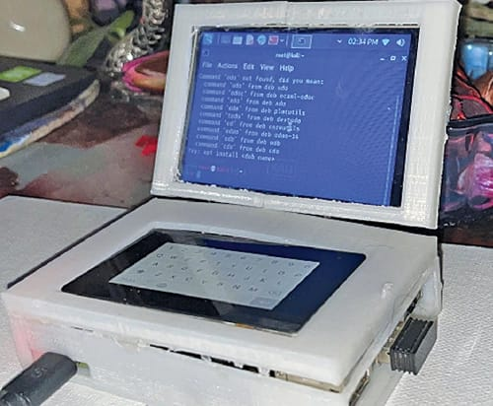
Diagram

Slide 6
Components
•3.3v •5v •NC •GND •TO_IRQ •LCD_RS •LCD_SI/TP_SI •TP_SO •RST •LCD_SCK/TP_SCK •LCD_CS •TP_CS

Slide 7
Realistic utitlity
•As small as our finger,portable, and easy to hide and carry anywhere. •Built-in full multi-touch keyboard. •Multi-touch display for working as a hacking tablet. •Equipped with Wi-Fi, BLE, and Bluetooth connectivity for wireless and network-based exploitation and penetration testing.

Slide 8
Thank you

